Slide 1
Food Supply & Death Attributed to Obesity
Ken Ye

Slide 2
Introduction

Slide 3
Obesity Crisis
Obesity Statistics:
U.S. obesity rate: 41.9% (2021 NHANES)
Global obesity-related deaths: 8% (2017) - up from 4.5% in 1990
Health Implications:
Obesity linked to severe conditions: heart disease, stroke, type 2 diabetes, and various cancers
Leading causes of preventable, premature deaths
Economic Burden:
Annual U.S. medical cost of obesity: nearly $173 billion (2019)
Medical costs for obese adults: $1,861 higher than healthy-weight individuals

Slide 4
Factors Affecting Obesity-attributed Death
Role of Food:
Continuous overconsumption emphasizes the importance of understanding food composition
Certain foods can significantly influence overall health outcomes
Beyond Food:
Economic status as a pivotal consideration
Developed countries with high incomes may have advanced medical systems but also higher obesity prevalence
Developing nations with lower incomes may face challenges emphasizing malnutrition over obesity

Slide 5
Research Goal & Target Audience
Analysis Focus:
Explore effects of a country's food supply and economic status on obesity-related death rates
Target Audience:
Policymakers (curb obesity-related deaths)
Consumers (craft diets resilient to detrimental effects of obesity)

Slide 6
Data

Slide 7
Data Source #1
Daily caloric supply (OWID based on UN FAO & historical sources)
Predictor variables (after renaming): Miscellaneous, Alcohol, Animal.fat, Vegetable.oils, Oilcrops, Fish.and.seafood, Sugar.crops, Sugar.sweeteners, Starchy.roots, Meat.other, Meat.sheep.and.goat, Meat.pig, Meat.poultry, Meat.beef, Eggs, Milk, Nuts, Fruit, Vegetables, Pulses, Cereals.other, Barley, Maize, Rice, Wheat — each one (25 total) is a food group available for consumption, continuous, unit (kcal per day per capita)
Source: Our World in Data based on UN FAO & historical sources — processed by Our World in Data
Link: https://www.fao.org/faostat/en/#data/FBS

Slide 8
Data Source #2
World Bank income classification
Predictor variable (after renaming): Income.group — nominal, four categories (Low-income countries, Lower-middle-income countries, Upper-middle-income countries, High-income countries)
Source: World Bank (2022) — processed by Our World in Data
Link: https://datahelpdesk.worldbank.org/knowledgebase/articles/906519-world-bank-country-and-lending-groups

Slide 9
Data Source #3
Share of total deaths that are from all causes attributed to high body-mass index, in both sexes aged age-standardized
Response variable (after renaming): Death.obesity — continuous, unit (%)
Source: IHME, Global Burden of Disease Study (2019) — processed by Our World in Data
Link: https://ourworldindata.org/obesity

Slide 10
Data Cleaning & Merging
Data Selection:
Chose the latest year (2019) for data congruence across all datasets
Excluded non-country entities (e.g., Africa) for focused analysis on individual countries
Variable Enhancement:
Renamed variables for improved legibility
Dataset Merging:
Employed inner join method on the "Country" variable
Resulting merged dataset consists of 181 observations and 28 columns

Slide 11
Missing Data Imputation
Missing Data Issue:
Identified missing values in certain food groups across countries
Removing entries would reduce the dataset to 79 out of 181 countries, limiting model robustness
Imputation Choice:
Opted for imputation using "predictive mean matching" (PMM) from the mice package
PMM ensures imputed values align with observed values, preserving data distribution
Rationale for Imputation:
Retained the full dataset for accurate representation of global patterns
Enhanced model validity and generalizability for diverse countries

Slide 12
Exploratory Data Analysis

Slide 13
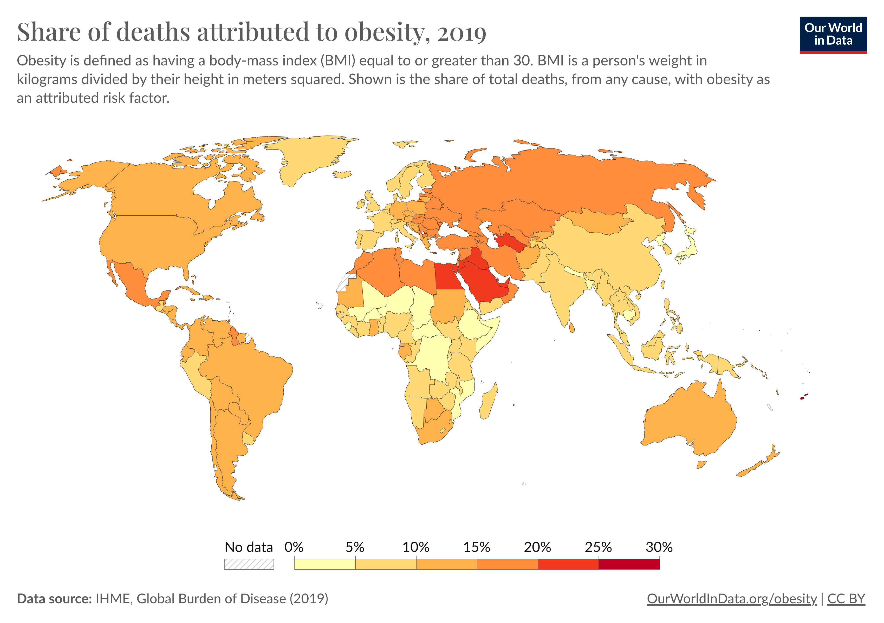
Obesity-attributed Death Visualization #1

Slide 14
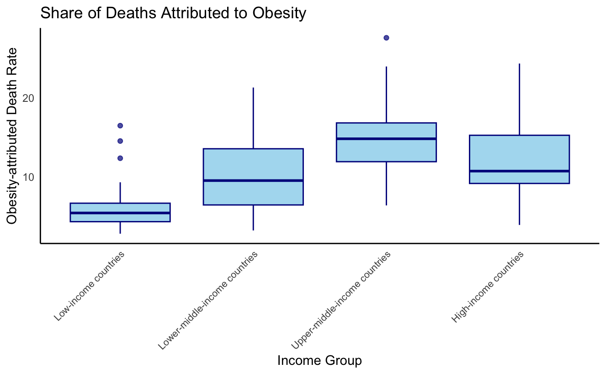
Obesity-attributed Death Visualization #2

Slide 15
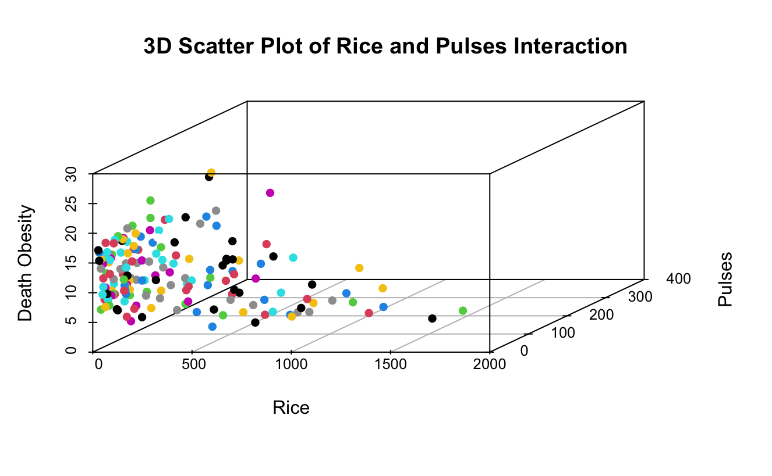
Exploration of Interaction Effects
Common Food Pairings:
Rice with beans, chicken with broccoli, steak with mashed potatoes, etc.
Objective:
Explore interaction effects between paired food groups on obesity-attributed death
Finding:
Coefficients for interaction terms lacked statistical significance

Slide 16
Methodology

Slide 17
Simple Linear Regression
Performance:
Multiple R-squared: 0.6466 (reasonable explained variability)
Significant Predictors:
Food groups: fish, seafood, sheep, goat, pig, poultry, beef, wheat
Income groups: lower-middle, upper-middle, and high-income countries
Overall Model Significance:
F-statistic significant (p-value: 2.181e-15)
Multicollinearity Check:
VIF values generally < 5, except for Upper-middle-income (VIF = 5.4) and High-income (VIF = 8.9) countries
Next Steps:
Further refinement and exploration through techniques like Lasso regression

Slide 18
Lasso Regression – Why?
Sparsity Induction:
Encourages sparsity in coefficient estimates
Facilitates automatic variable selection
Multicollinearity Handling:
Addresses multicollinearity by favoring a unique subset of correlated predictors, ensuring stability and interpretability
Robustness through Regularization:
Enhances resilience to data fluctuations
Improves predictive accuracy
Standardization Importance:
Crucial for predictors related to food groups
Ensures all variables are on the same scale for a fair comparison

Slide 19
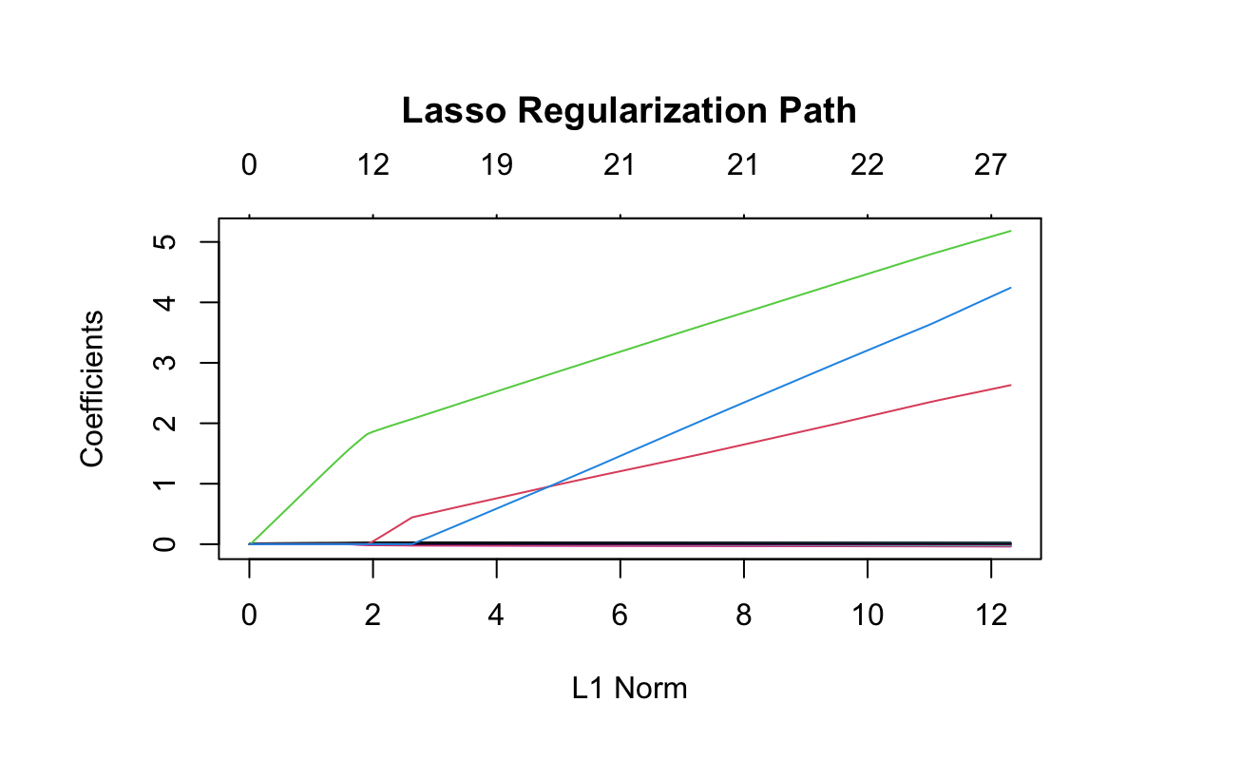
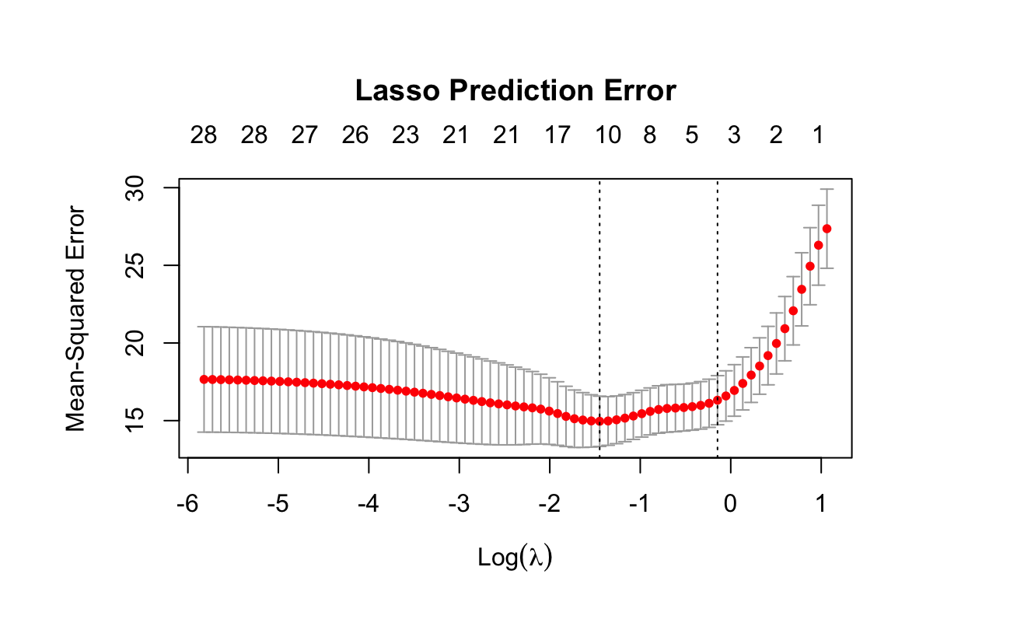
Lasso Regression
Ten-Fold Cross-Validation (CV):
Employed to identify optimal lambda value
Optimal lambda value determined: 0.23
Final Model Construction:
Utilized the optimal lambda value for constructing the final Lasso model

Slide 20
Model Comparison
Lasso vs. Simple Linear Regression:
Substantial improvement in prediction accuracy observed
Testing Mean Squared Error (MSE) decreased significantly
Simple linear regression model MSE: 44.6
Lasso model MSE: 7.8
Noteworthy reduction highlights Lasso's superior predictive capabilities

Slide 21
Results

Slide 22
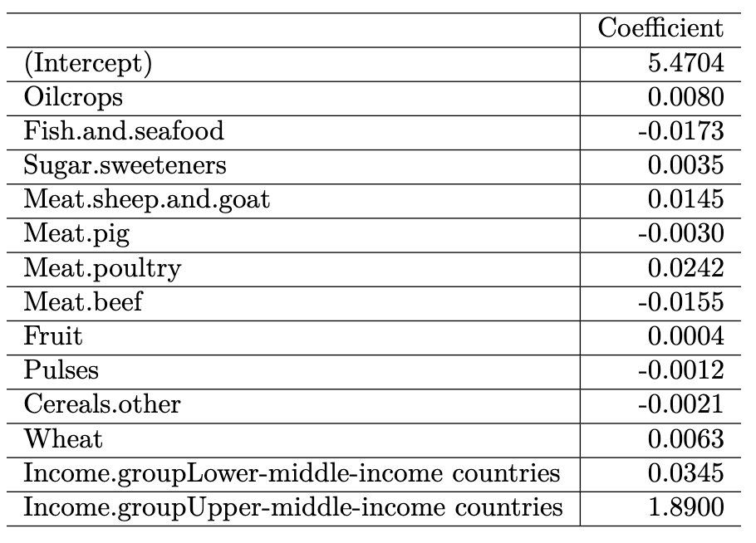
Final Model (Lasso)

Slide 23
Implications
Policymaker Insights:
Tailored Interventions:
Positive coefficient for Lower-middle-income countries emphasizes the need for targeted public health initiatives
Efficient Resource Allocation:
Insights from Income Group coefficients facilitate efficient resource allocation, addressing economic disparities in combating obesity-related health risks
Consumer Guidance:
Moderation in Processed Foods:
Understanding the impact of Sugar Sweeteners encourages moderation in processed food consumption
Dietary Substitutions:
Negative coefficient for Fish and Seafood suggests substituting red meat with fish for potential health benefits
Balanced Diet Insights:
Nuanced effects of different meat types provide guidance for achieving a balanced diet
Whole Grains and Fiber:
Encourages consumers to incorporate whole grains and fiber-rich foods for better weight management

Slide 24
Conclusion

Slide 25
Summary
Global Impact:
Explored obesity-related deaths, emphasizing health crises and economic burden globally
Dual-Stage Methodology:
Identified significant factors, revealing distinct links between economic status (income groups) and mortality rates
Economic Status Insights:
Lower-middle-income countries linked to increased death rates, urging targeted interventions. Further investigation needed for rising mortality rates in upper-middle-income countries
Food Group Impact:
Positive associations with oil-rich crops and sugar sweeteners, indicating potential health risks. Negative associations with fish and seafood suggest protective effects, guiding healthier dietary choices
Lasso Regression Refinement:
Refined variable selection, emphasizing specific food groups and economic factors in predicting mortality rates
Practical Implications:
Policymakers gain insights for targeted interventions and efficient resource allocation. Consumers empowered for informed dietary choices, managing weight and enhancing overall health

Slide 26
Limitations and Future Research
Data Limitation:
Relied on food supply data, not precise for consumption, especially in high-income countries with potential food waste
Scope Limitation:
Primarily focused on food supply and income, neglecting other factors like physical activity and healthcare systems
Recommendation:
Future research should include additional variables for a more comprehensive understanding of obesity-related deaths

Slide 27
Citations

Slide 28
Citations
https://www.cdc.gov/obesity
https://ourworldindata.org/obesity

Slide 29
Thank You!

